Slide 1

Hidden ASP.NET Peformance Problems
Matt Watson
Founder & CEO, Stackify

Slide 2





































TITANIUM SPONSORS
Platinum Sponsors
Gold Sponsors

Slide 3
Tip #1 Hidden Exceptions!

Slide 4
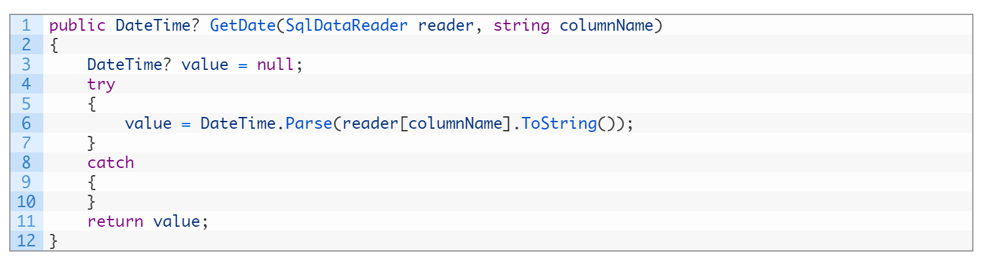

Avoid silly exceptions
© Stackify, 2016

Slide 5
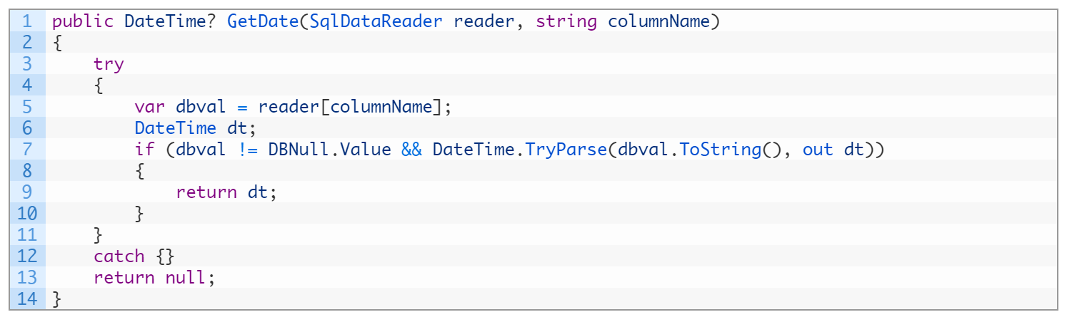
Use TryParse methods
© Stackify, 2016

Slide 6
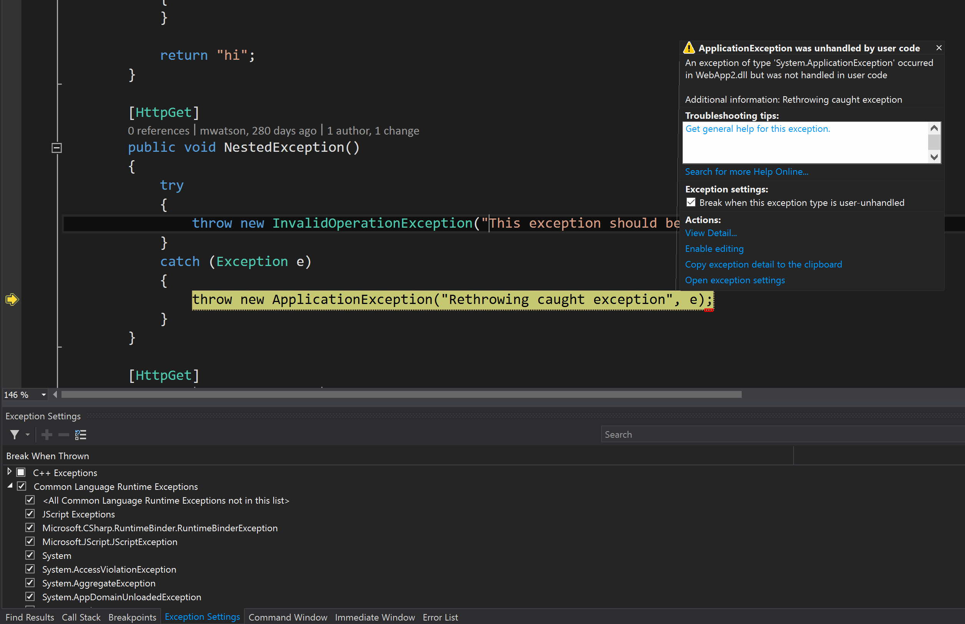
Break on First Chance Exceptions
© Stackify, 2016

Slide 7
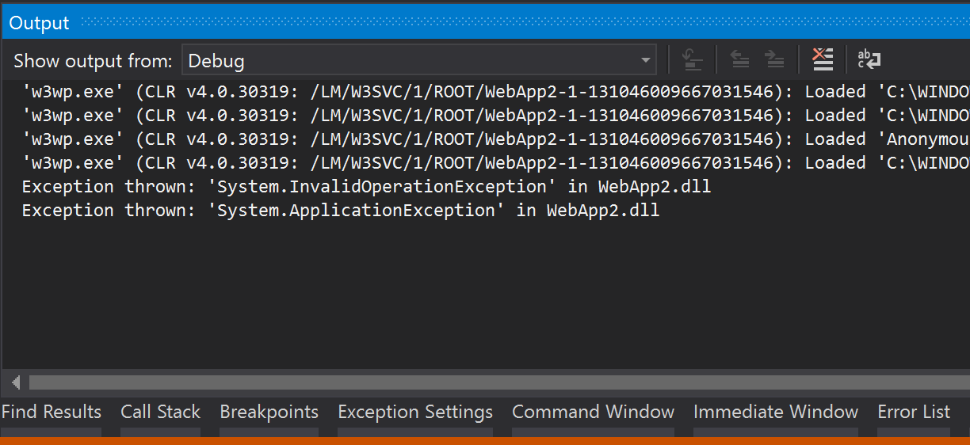
When not Breaking…
© Stackify, 2016

Slide 8
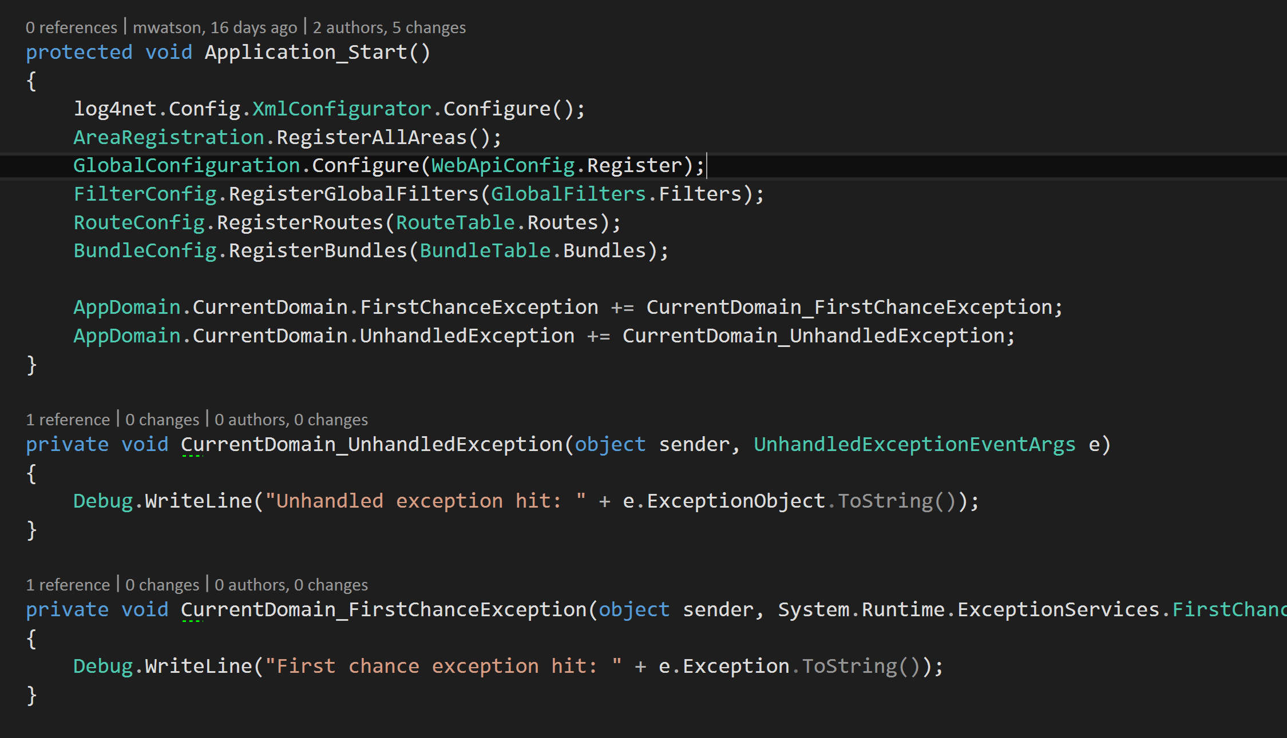
Subscribe to first chance exceptions
© Stackify, 2016

Slide 9
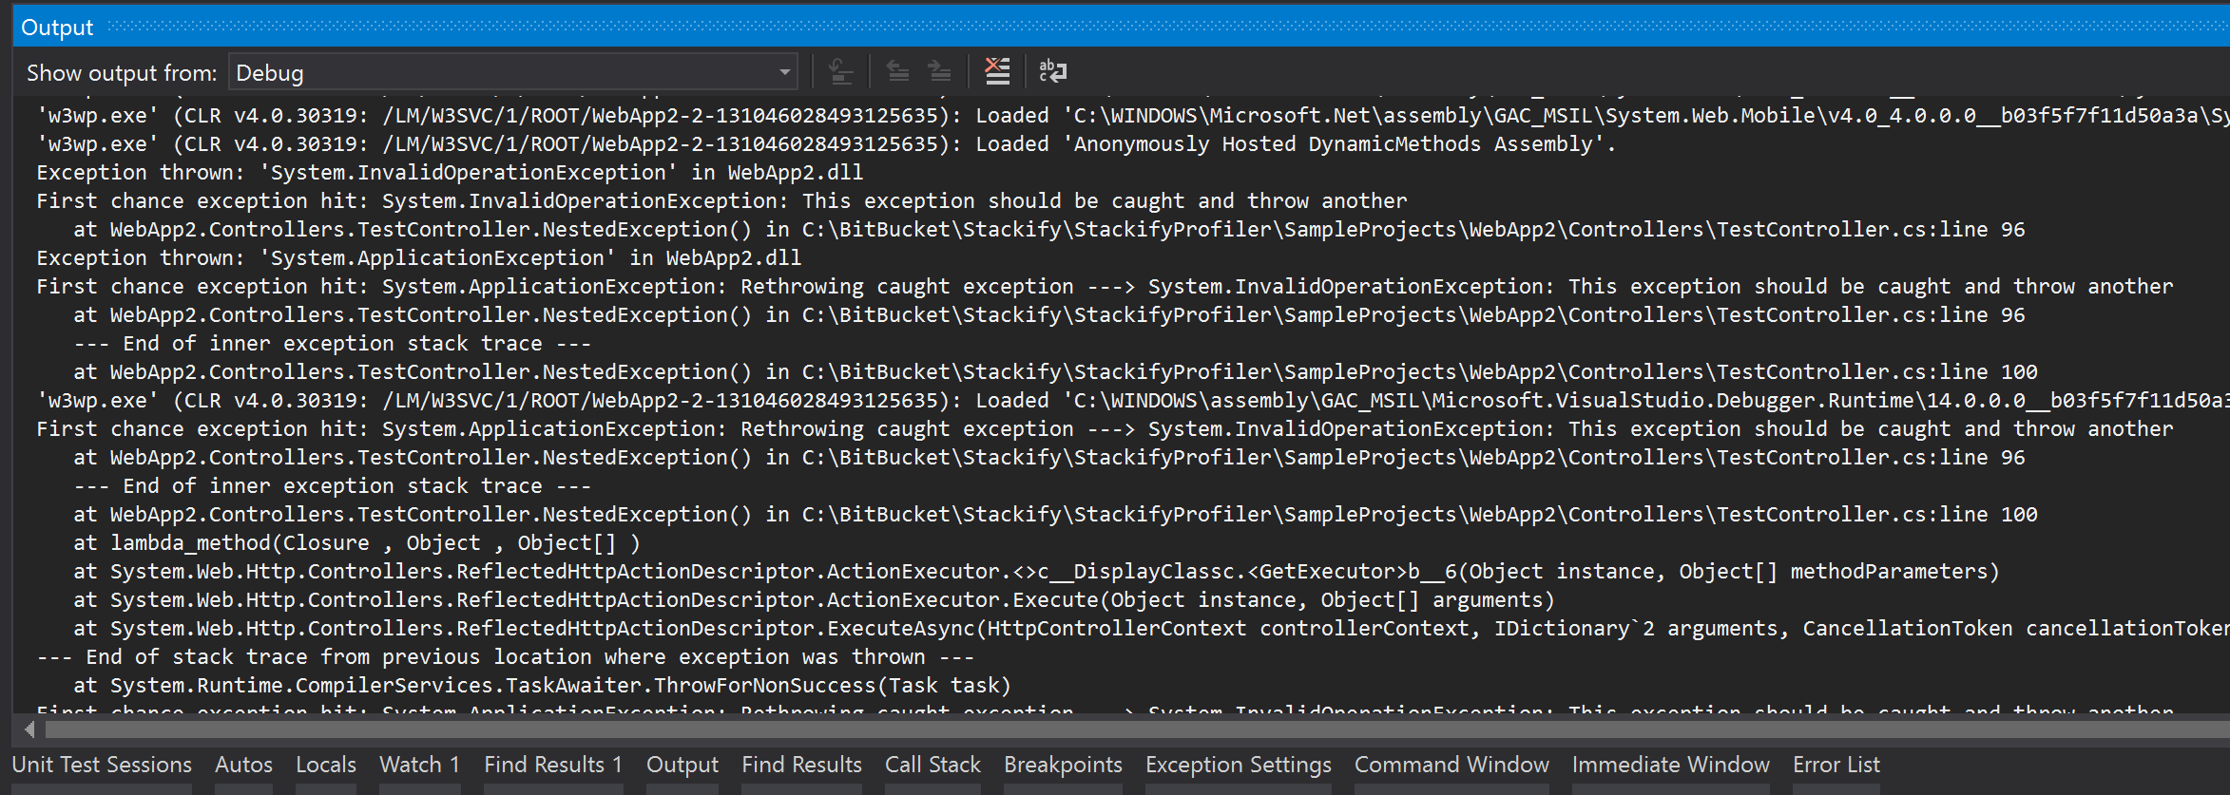
Viewing the output
© Stackify, 2016

Slide 10
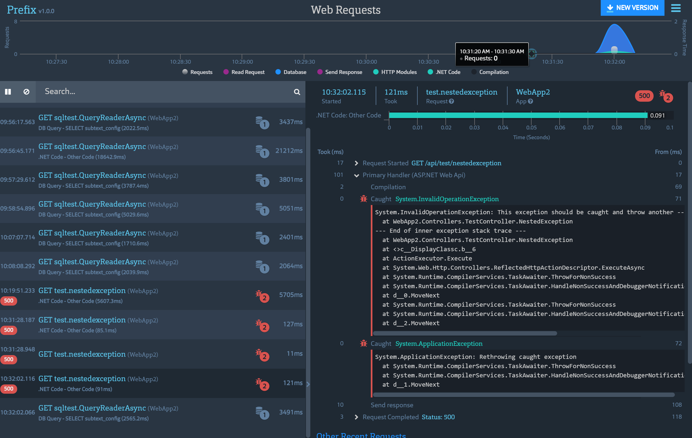
© Stackify, 2016

Slide 11
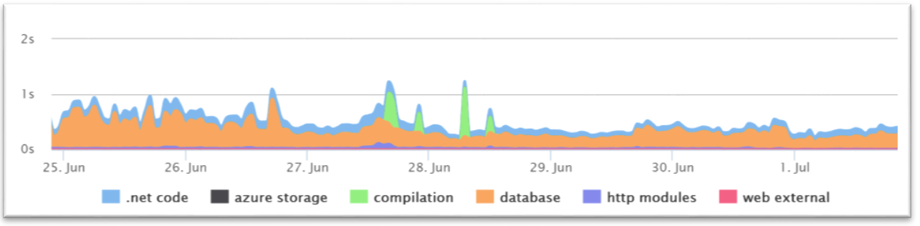
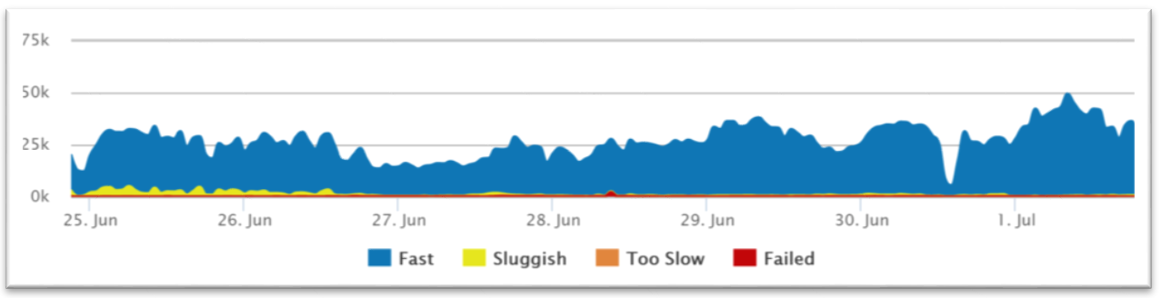
Improve page load times
© Stackify, 2016

Slide 12
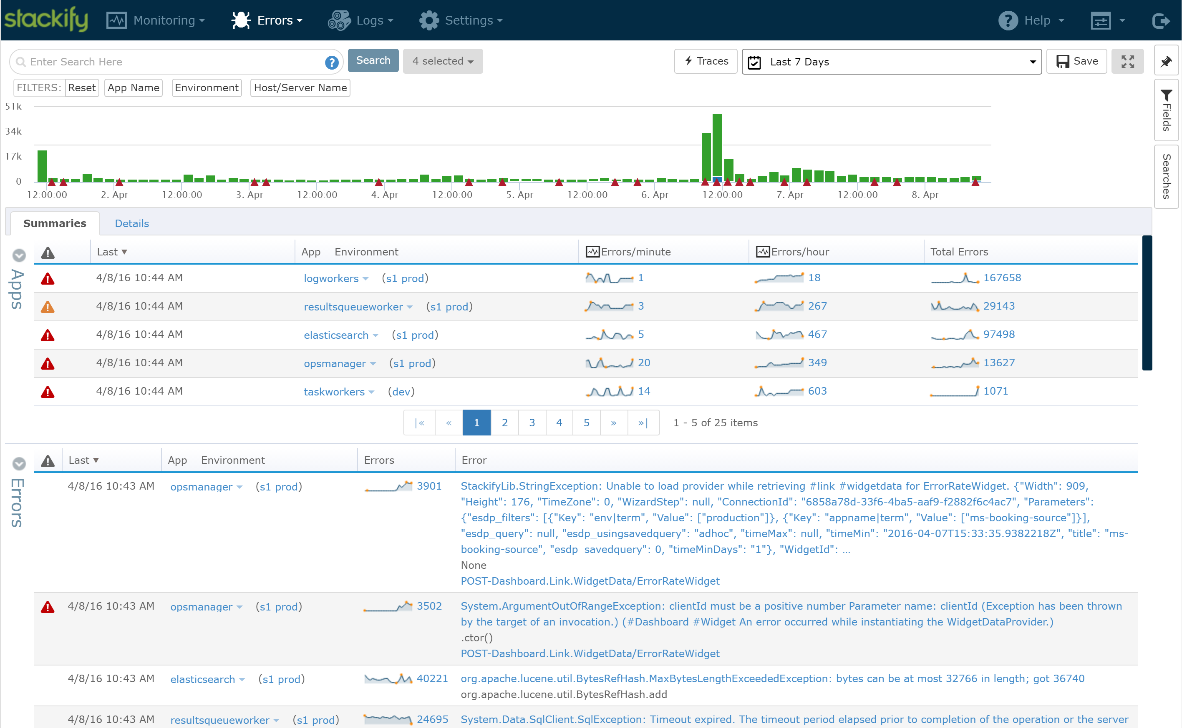
© Stackify, 2016

Slide 13
Exceptions best practices
Avoid them at all costs ☺
Find hidden exceptions with Prefix
Track all first chance exceptions to hunt them down
Aggregate all exceptions in production
© Stackify, 2016

Slide 14
Tip #2 Serialization

Slide 15
Web requests
Serialize Request
Send Request
Receive Response Headers
Download Response
Deserialize Response
© Stackify, 2016

Slide 16
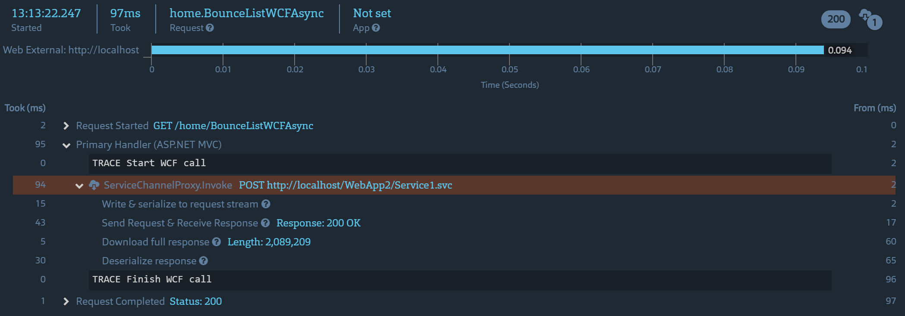
Breaking down a WCF request client side
© Stackify, 2016

Slide 17
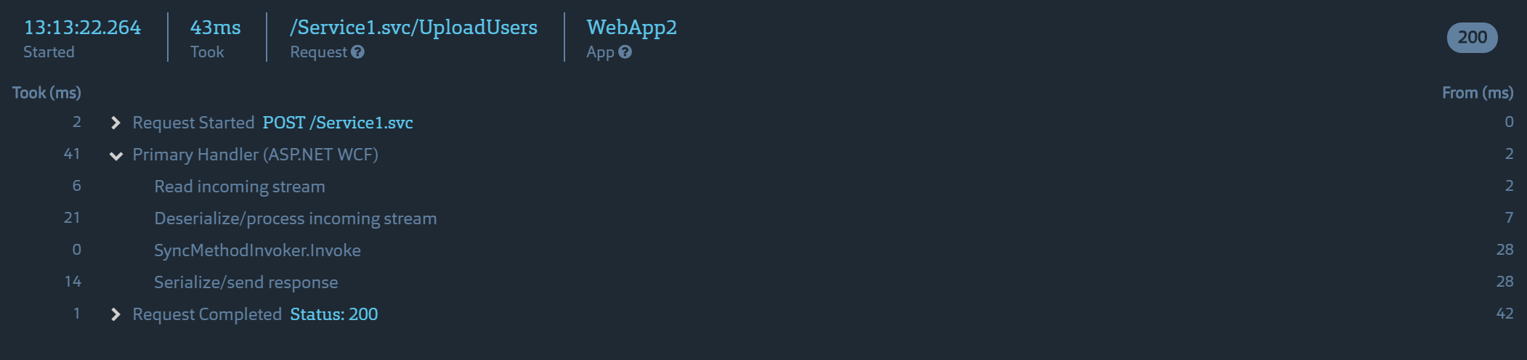
Breaking down a WCF request server side
© Stackify, 2016

Slide 18
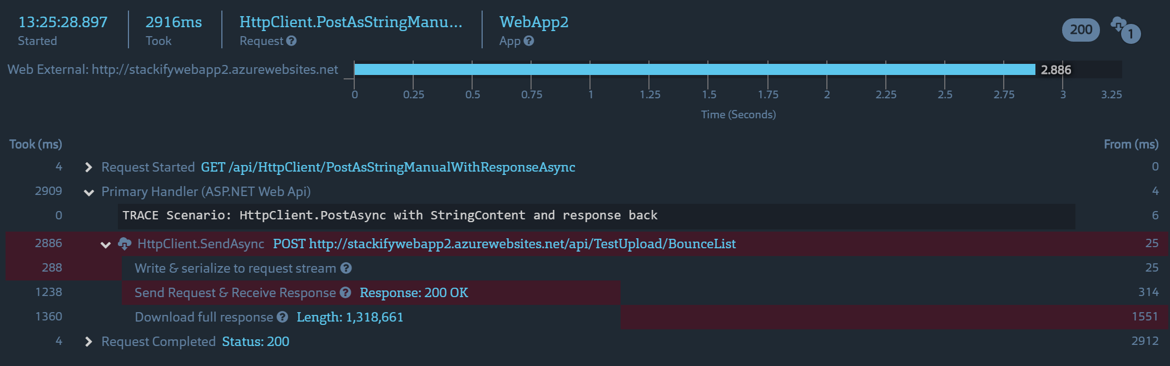
REST call client side
© Stackify, 2016

Slide 19
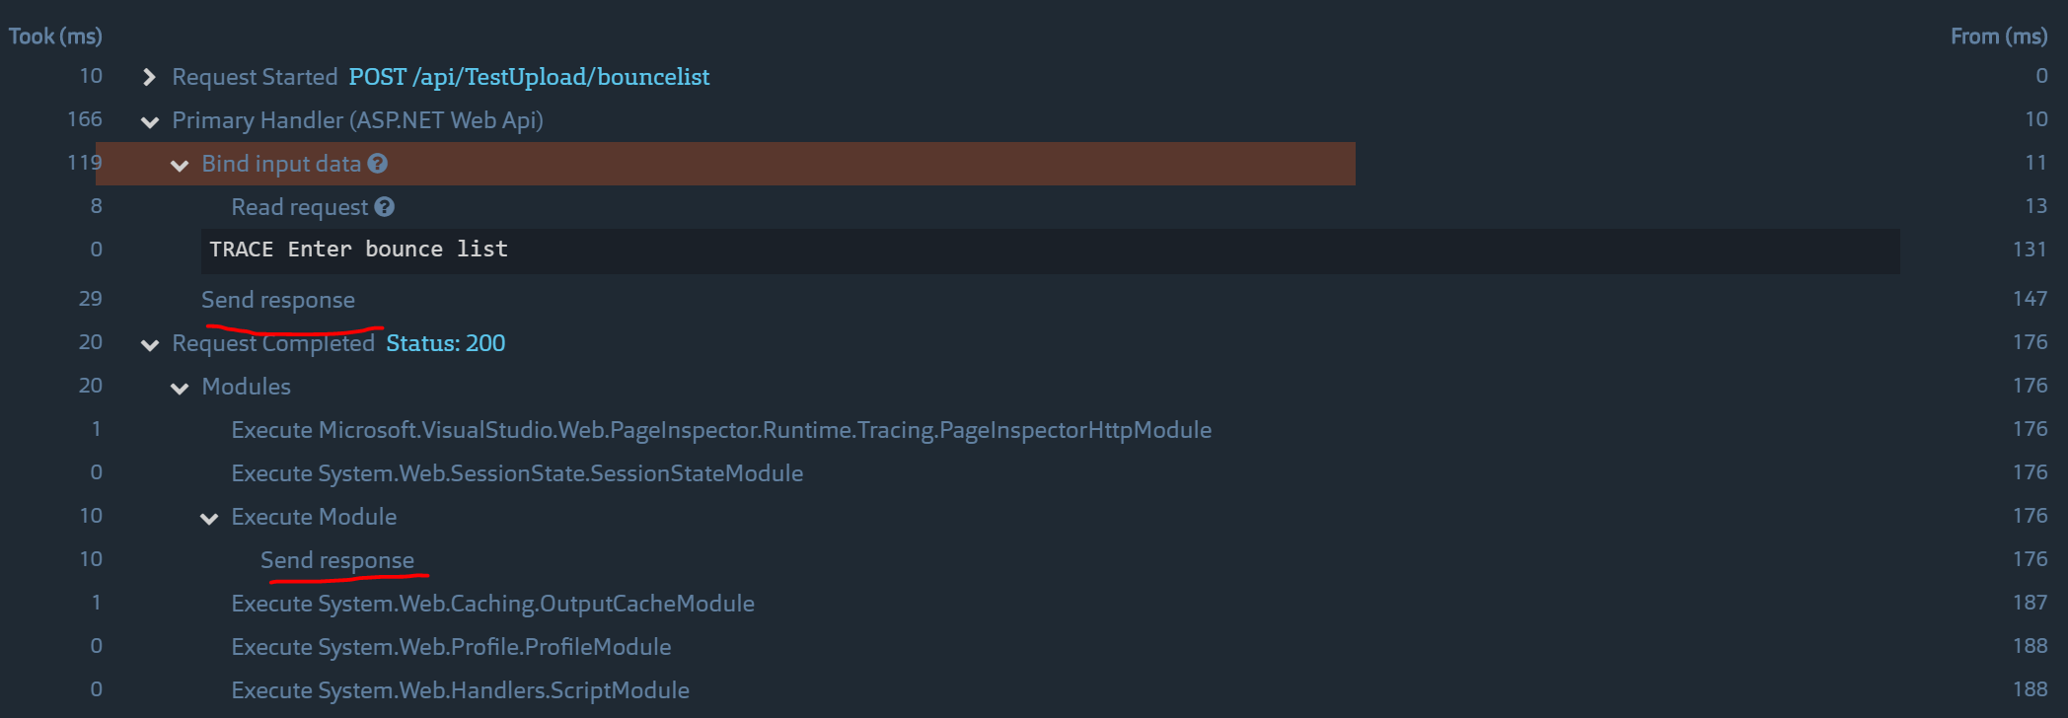
REST call server side
© Stackify, 2016

Slide 20
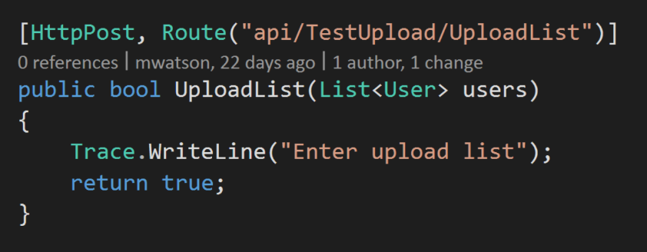
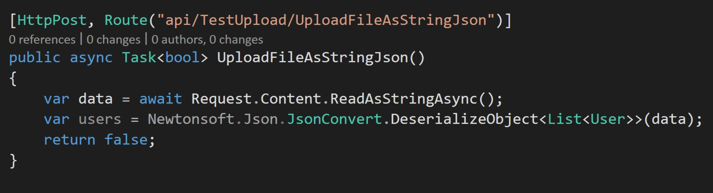
Reading incoming data
© Stackify, 2016

Slide 21
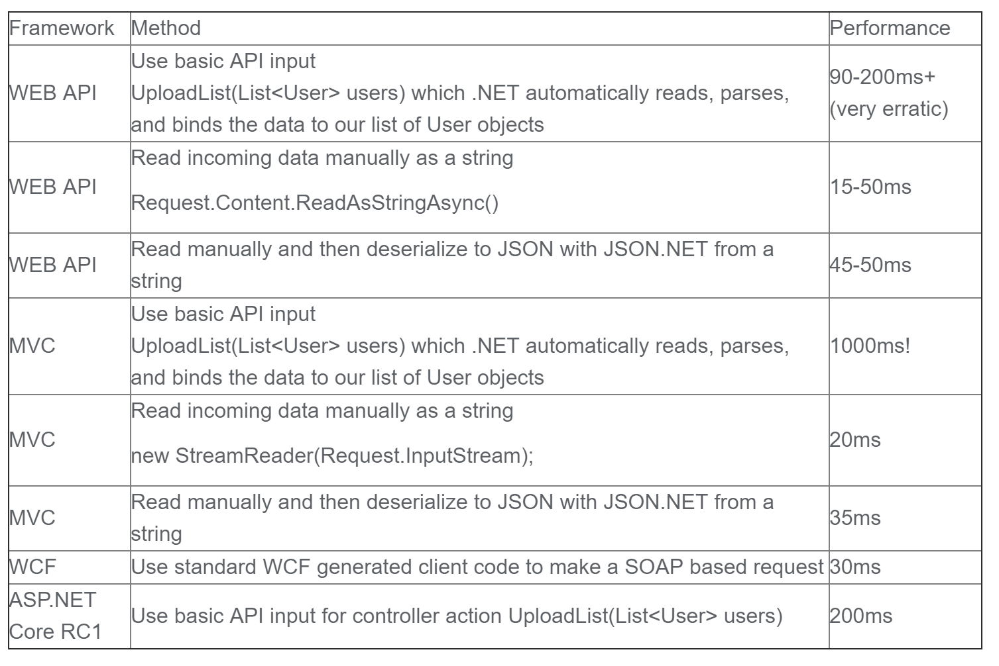
Comparing different usages
© Stackify, 2016

Slide 22
Web request & serialization tips
Understand payload size
Customize JSON serializers
Consider manually reading incoming data
© Stackify, 2016

Slide 23
Tip #3 SSL Overhead

Slide 24
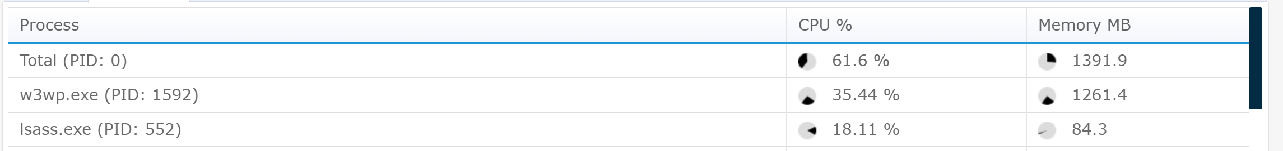
SSL Overhead on Windows
© Stackify, 2016

Slide 25
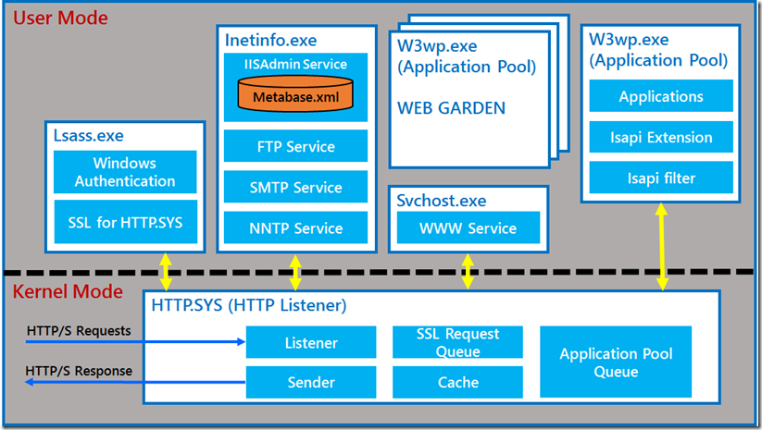
IIS Architecture
© Stackify, 2016

Slide 26
SSL Tips
Offload SSL to load balancer or hardware if possible
Netscaler, F5, etc
Use Azure Application Gateway for SSL offloading
AWS use ELB with SSL
© Stackify, 2016

Slide 27
Tip #4 Garbage collection

Slide 28
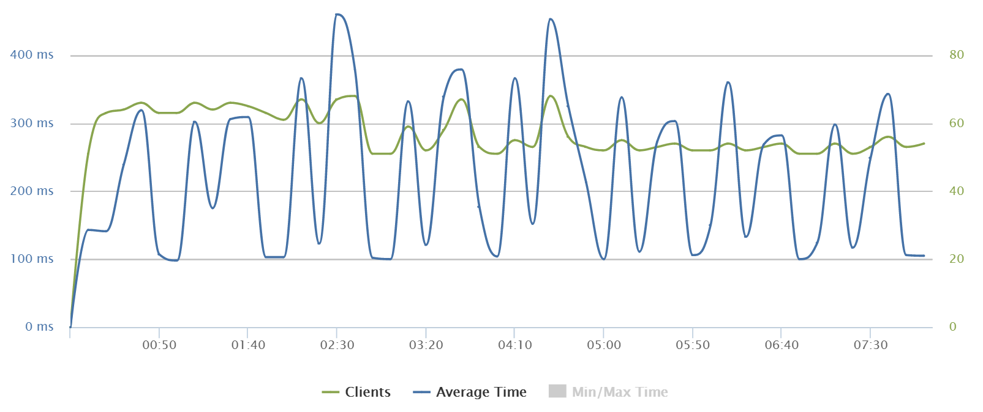
Garbage collection pauses ☹
© Stackify, 2016

Slide 29
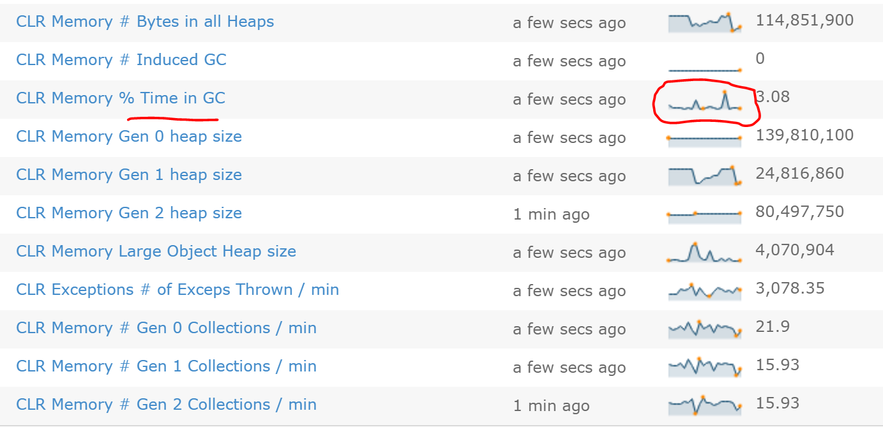
Monitoring GC Time
© Stackify, 2016

Slide 30
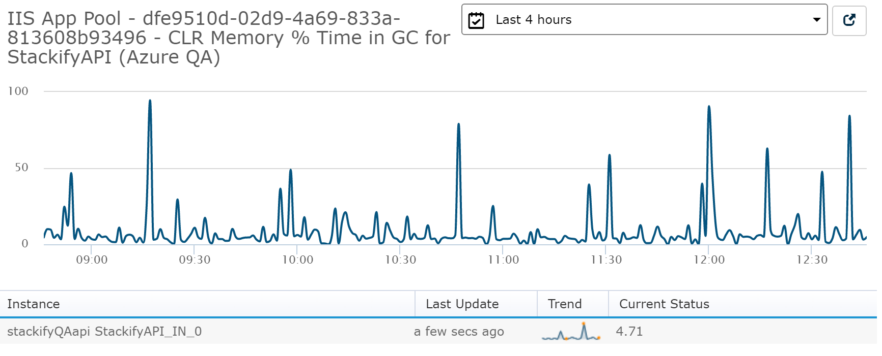
Monitoring GC Time
© Stackify, 2016

Slide 31
Garbage Collection Tips
Avoid the large object heap
Use streams where you can
Avoid large strings
Server vs workstation GC mode <gcServer>
Monitor GC performance counters
© Stackify, 2016

Slide 32
Tip #5 Real SQL Performance

Slide 33
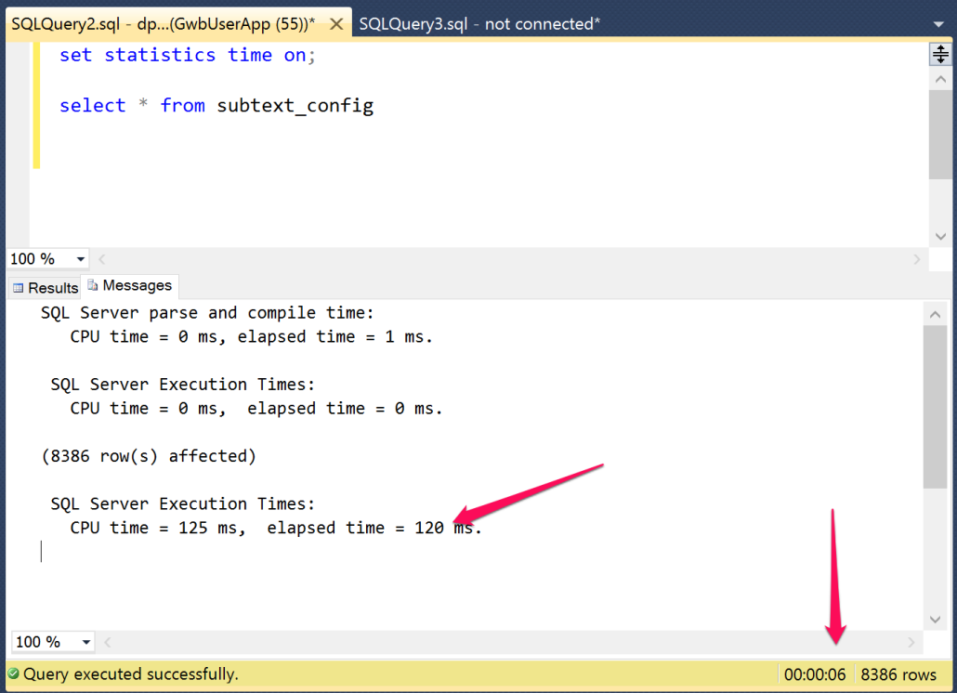
© Stackify, 2016

Slide 34
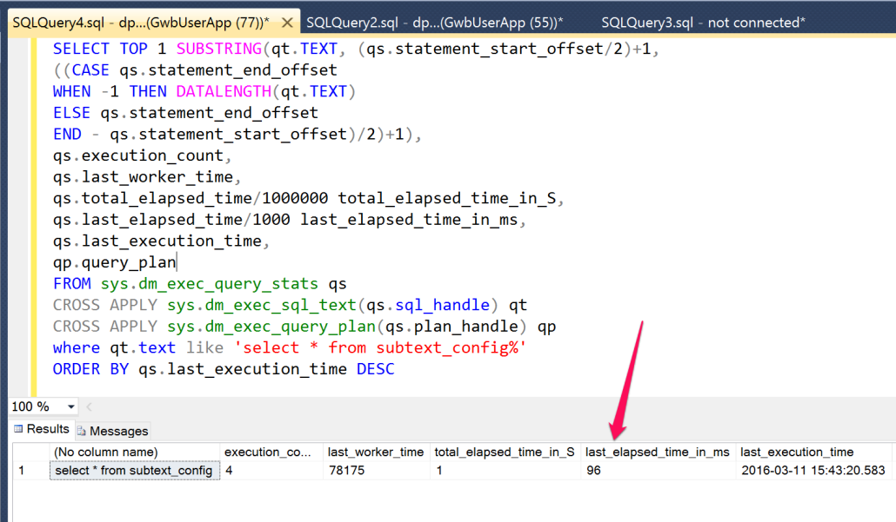
© Stackify, 2016

Slide 35
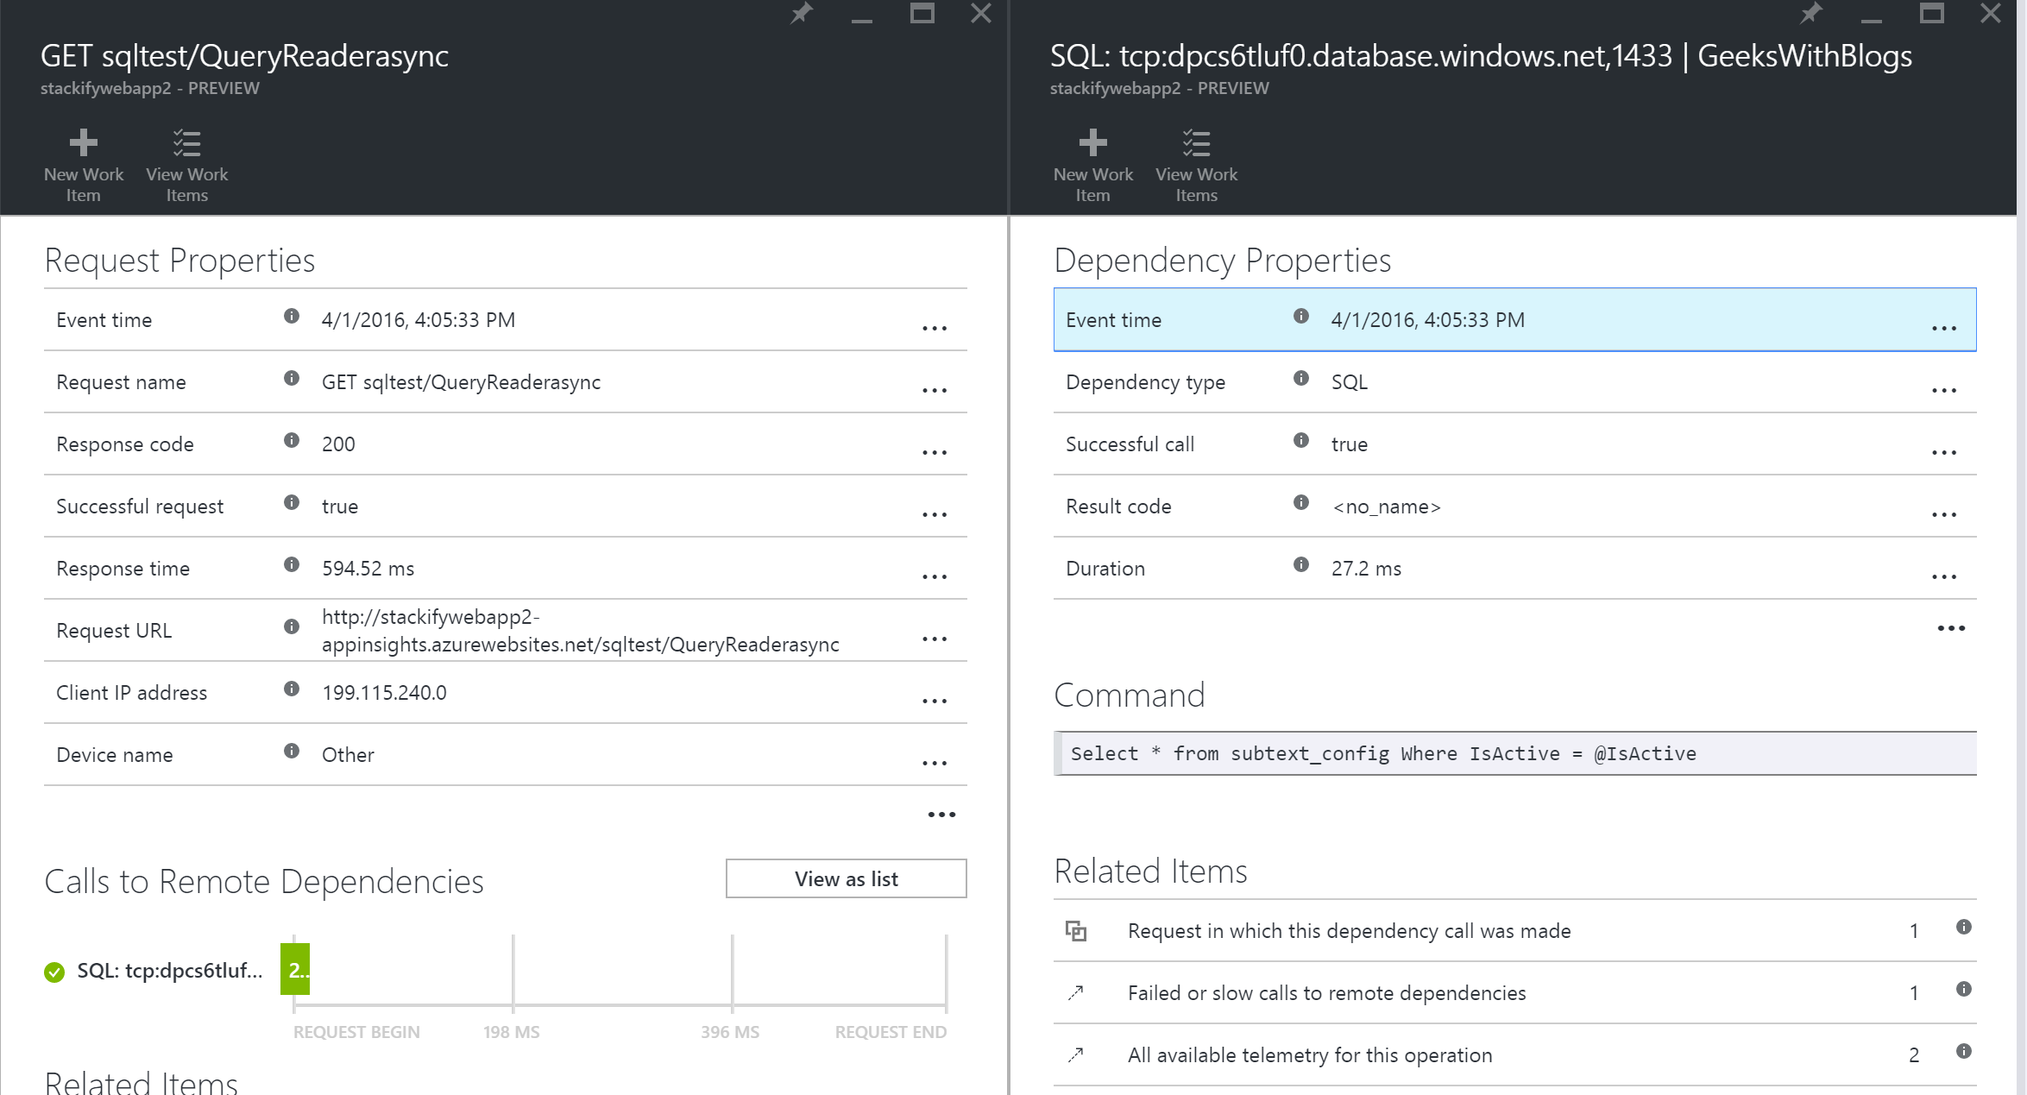
What does App Insights say?
© Stackify, 2016

Slide 36
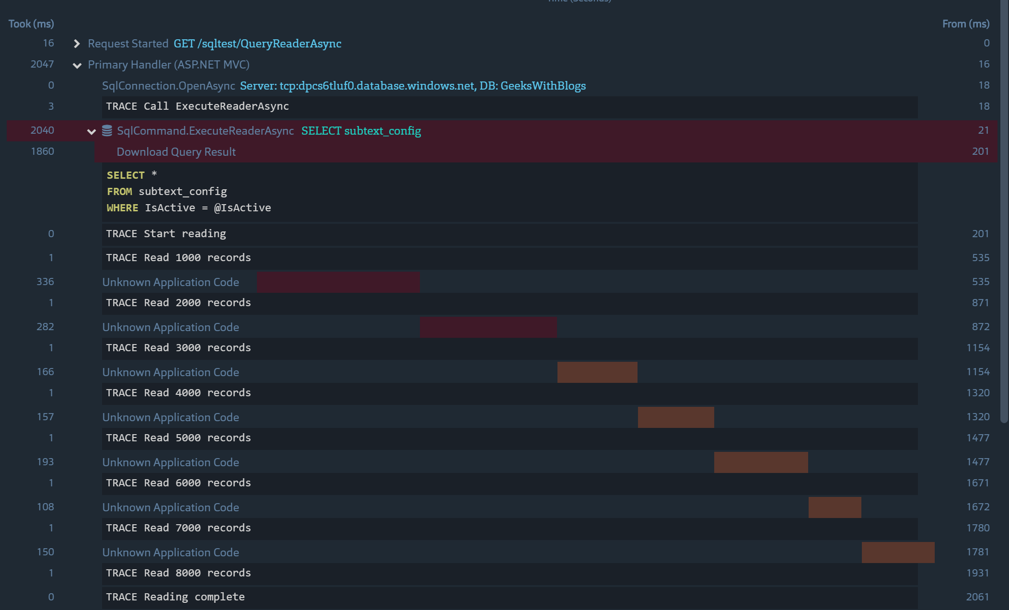
© Stackify, 2016

Slide 37
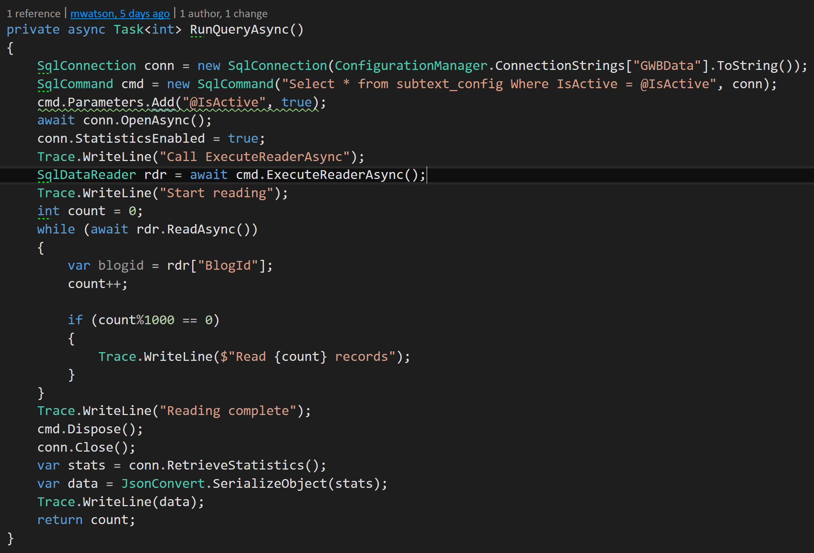
© Stackify, 2016

Slide 38
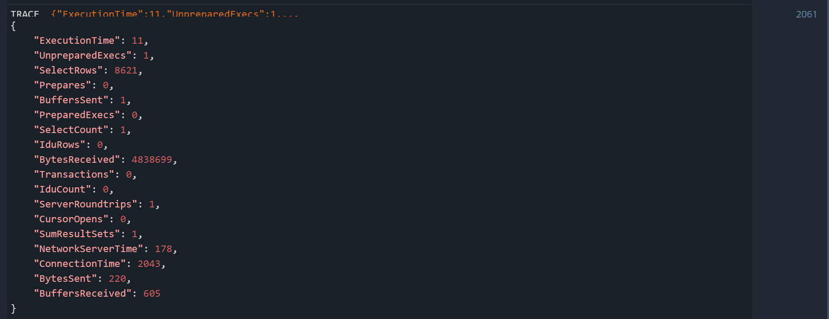
SQL Connection Statistics
© Stackify, 2016

Slide 39
SQL Performance Tips
SQL server performance != real world performance
Your SQL performance reports are probably all wrong!
Use your logging or Prefix to understand real world performance
© Stackify, 2016

Slide 40
Questions?

